Slide 1
Marketing Mix
Modeling of
2014 - 2017
MÀPÉ
Analyst: Hannah Hou
| hannah.d.hou@gmail.com

Slide 2
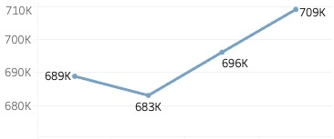

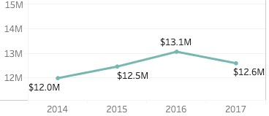
Background
Total spend:
Compared to 2016, while MÀPÉ has increased its marketing spend for 2% at 2017, the total sales has decreased for 4%.
Mapeí is a leather good
fashion design company
Total sales:
Using marketing mix modeling & optimization technique, we can increase 4% of sales in 2018, returning to the level in 2016 (13M), with similar media spend in 2017.

Slide 3
Factors Considered
Macroeconomics
Media channel
Sales Event
National TV
Holiday Sales:
(Black Friday, July 4th)
Magazine
Factors that affect our
marketing mix model
Paid Search
Display
Media
Facebook
WeChat
Competitor Spends

Slide 4
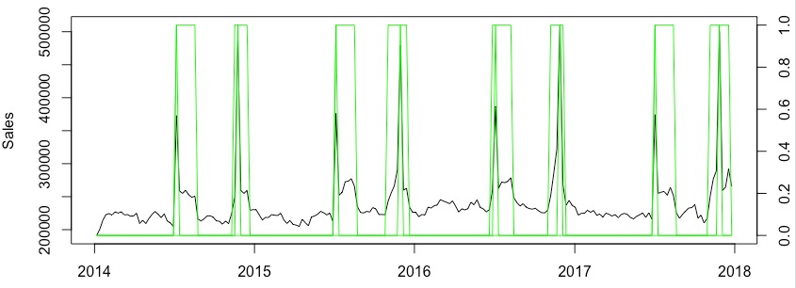
Explore the Spikes of Sales
Sales trend line with Sales Event & Holiday Sales (Black Friday & July 4th) :

Slide 5
Modeling
R code:
lm(formula = Sales ~ July_4th + Black_Friday + CCI + Sales.Event + NationalTV2 + PaidSearch1 + Wechat2 + Magazine1 + Display2 + Facebook1 + Comp.Media.Spend, data = AF)
 | Decay | Lag | Alpha
National TV GRPs | 0.8 | 1 | 0.6
Magazine GRPs | 0.7 | 1 | 0.6
Paid Search | 0.9 | 0 | 1
Display | 1 | 0 | 1
Facebook Impressions | 1 | 0 | 0.8
WeChat | 0.9 | 1 | 1
Y: Sales
X: July_4th + Black_Friday + CCI + Sales.Event + NationalTV2 + PaidSearch1 + Wechat2 + Magazine1 + Display2 + Facebook1 + Comp.Media.Spend
Media Transformation
Dependent variables & Independent variables

Slide 6
Modeling
Coefficients:
 | Estimate | Std. Error | t value | Pr(>|t|) | Significant level
(Intercept) | 1.52E+05 | 1.35E+04 | 11.282 | < 2e-16 | ***
July_4th | 1.20E+05 | 4.12E+03 | 29.019 | < 2e-16 | ***
Black_Friday | 2.21E+05 | 4.87E+03 | 45.477 | < 2e-16 | ***
CCI | 2.50E+02 | 1.21E+02 | 2.07 | 0.0398 | *
Sales.Event | 2.89E+04 | 1.64E+03 | 17.619 | < 2e-16 | ***
NationalTV2 | 1.37E+03 | 3.33E+02 | 4.126 | 5.46E-05 | ***
PaidSearch1 | 5.40E-02 | 1.35E-02 | 3.996 | 9.10E-05 | ***
Wechat2 | 5.02E+00 | 1.01E+00 | 4.976 | 1.42E-06 | ***
Magazine1 | 1.74E+03 | 2.50E+02 | 6.946 | 5.42E-11 | ***
Display2 | 2.74E-04 | 1.54E-04 | 1.782 | 0.0762 | .
Facebook1 | 1.03E-02 | 1.41E-03 | 7.304 | 6.87E-12 | ***
Comp.Media.Spend | -4.86E-01 | 8.08E-02 | -6.013 | 8.77E-09 | ***
Signif. codes:
0 : ‘***’ , 0.001: ‘**’ , 0.01: ‘*’ ,0.05: ‘.’ , 0.1 ‘ ’
Residual standard error:
7674 on 196 degrees of freedom
R-squared: 0.97
MAPE: 2%
F-statistic: 637.5 on 11 and 196 DF
p-value: < 2.2e-16

Slide 7
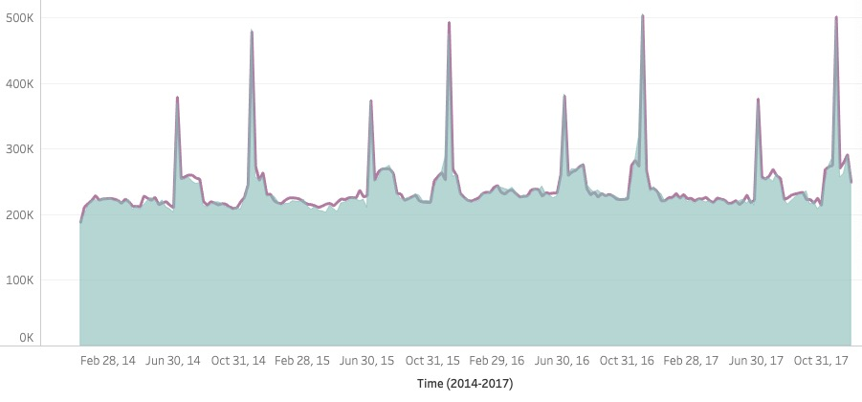
Actual VS Model
R-squared: 0.97
MAPE: 2%

Slide 8
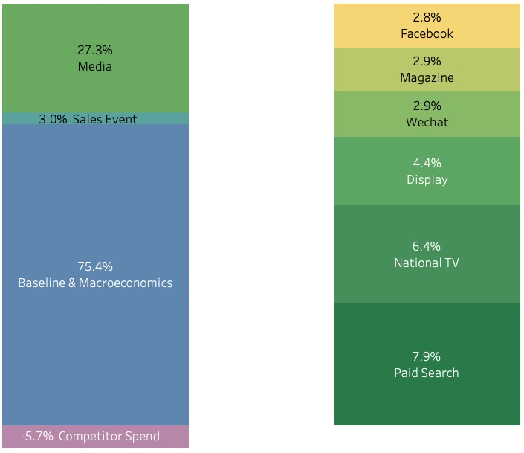
Media Contribution %

Slide 9
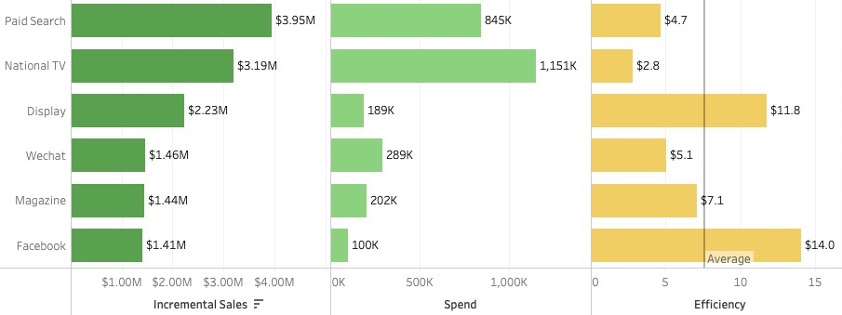
Channel Break Down
Facebook and Display media are more efficient (have higher ROI) than the other channels.

Slide 10
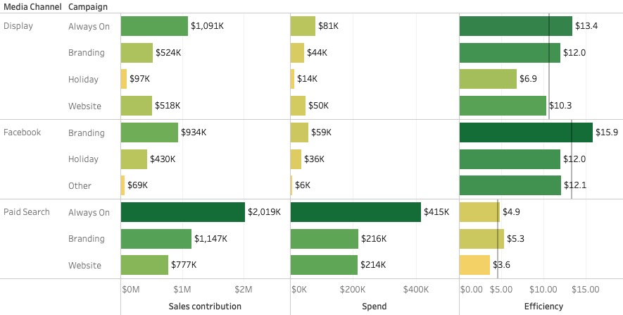
Side Diagnostic
Always on and Branding campaigns are more efficient (have higher ROI).

Slide 11
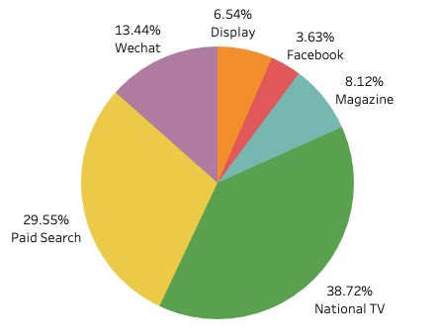

2018 Media Planned Spend

Slide 12
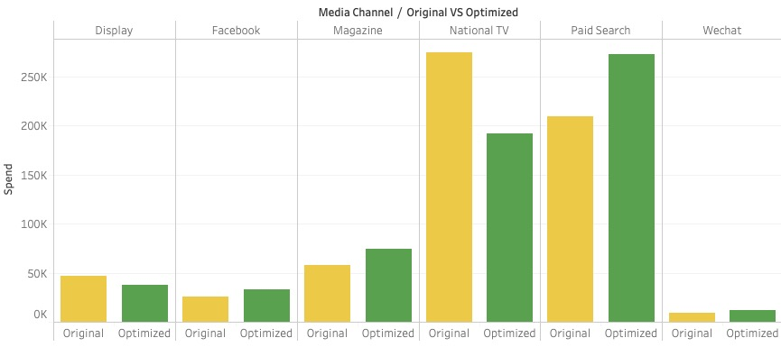
2018 Media Plan Optimization
Through the media channel spend optimization from linear model programming, we recommend to reduce the budget for traditional media (National TV), and increase the budget for new & digital media channel.
Objective: Total Sales
Variables: Media Spend
Constraint:
Total media spend stays the same.
Each optimized media spend is constrained within +/- 30% of the planned to avoid market volatility
+30%
-30%
+9%
+30%
+30%
+30%

Slide 13
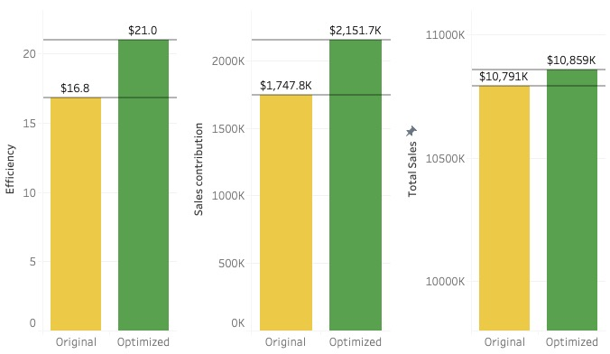
Expected optimization outcome
After the optimization of Media Spend while keeping the total budget stays the same, we’ve projected 14% lift on Efficiency(ROI), 14% lift on Media Sales Contribution, and 4% lift on Total Sales.
+ 4%
+14%
+14%

Slide 14

Summary
Display & Facebook has better ROI (Efficiency), much higher than the other channel.
(Display: 11.8$, Facebook: 14.0$)
The most efficient media channel is Facebook, which contribute to 10.2% of Media Sales using only 3.6% of Media Spend.
Through optimization, we can expect a 4% (404k $) lift on Total Sales, and 14% (4.2$) lift on Efficiency (ROI) than the original media plan.

Slide 15

Thanks!
Do you have any questions?
hannah.d.hou@gmail.com
https://www.linkedin.com/in/hannah-hou-0b040b173/

